Slide 1




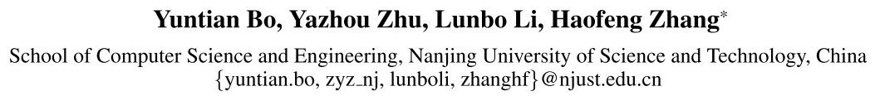





ATAI
Advanced Techniqueof Artificial Intelligence
ATAI
ChongqingUniversity _{AdvancedTechniqueof}
of Technology Artificial Intelligence
Chongqing University of
Technology
Chongqing University ^{ATAI}
_{of Technology} Advanced Techniqueof
Artificial Intelligence
Chongqing University of Technology
Chongqing University of Technology
FAMNet: Frequency-aware Matching Network for Cross-domain Few-shot Medical Image Segmentation
Code: https://github.com/primebo1/FAMNet.
—— AAAI 2025
Reported by Tingting Zhang
1

Slide 2

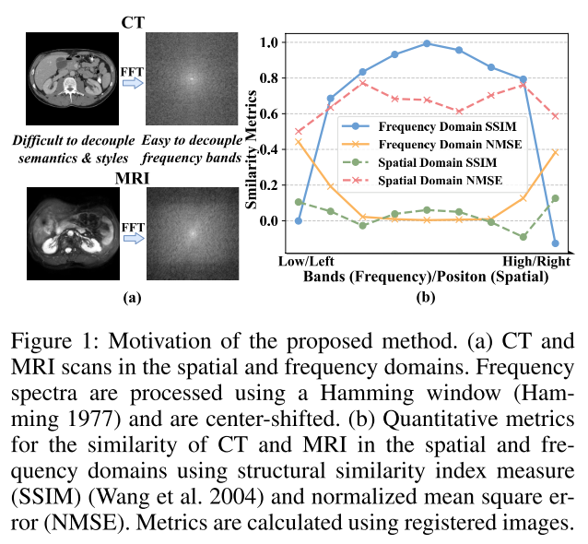
ATAI
AdvancedTechniqueof
Artificial Intelligence
ATAI
ChongqingUniversity _{AdvancedTechniqueof}
of Technology Artificial Intelligence
ChongqingUniversity of Technology
Motivation
1) Intra-domain variations: Medical images exhibit significant variability between individual organs.
2) Inter-domain variations: Even within the same organ or region, the spatial domain similarity demonstrates low correlation across different domains.
Notes:
现有方法虽然取得了一定的性能，但仍存在以下几个缺陷：
1）跨模态特征融合不足。如图1（a）所示，现有方法通常采用拼接、相加、相似性重新加权和注意力来融合来自不同模态的特征。然而，诸如连接和添加的线性操作不考虑上下文语义信息。虽然相似性加权和注意力可以捕获跨模态特征的一致性，但它只代表了原始信息的一部分。
2)模糊特征分类现有的方法仅在新闻级别（图像-文本对）实现检测，并且不考虑特征级别（图像和文本之间）的差异。如图1（a）所示，由于来自不同新闻的跨模态特征的高度相似性，这可能导致图像-文本对的不正确配对。

Slide 3

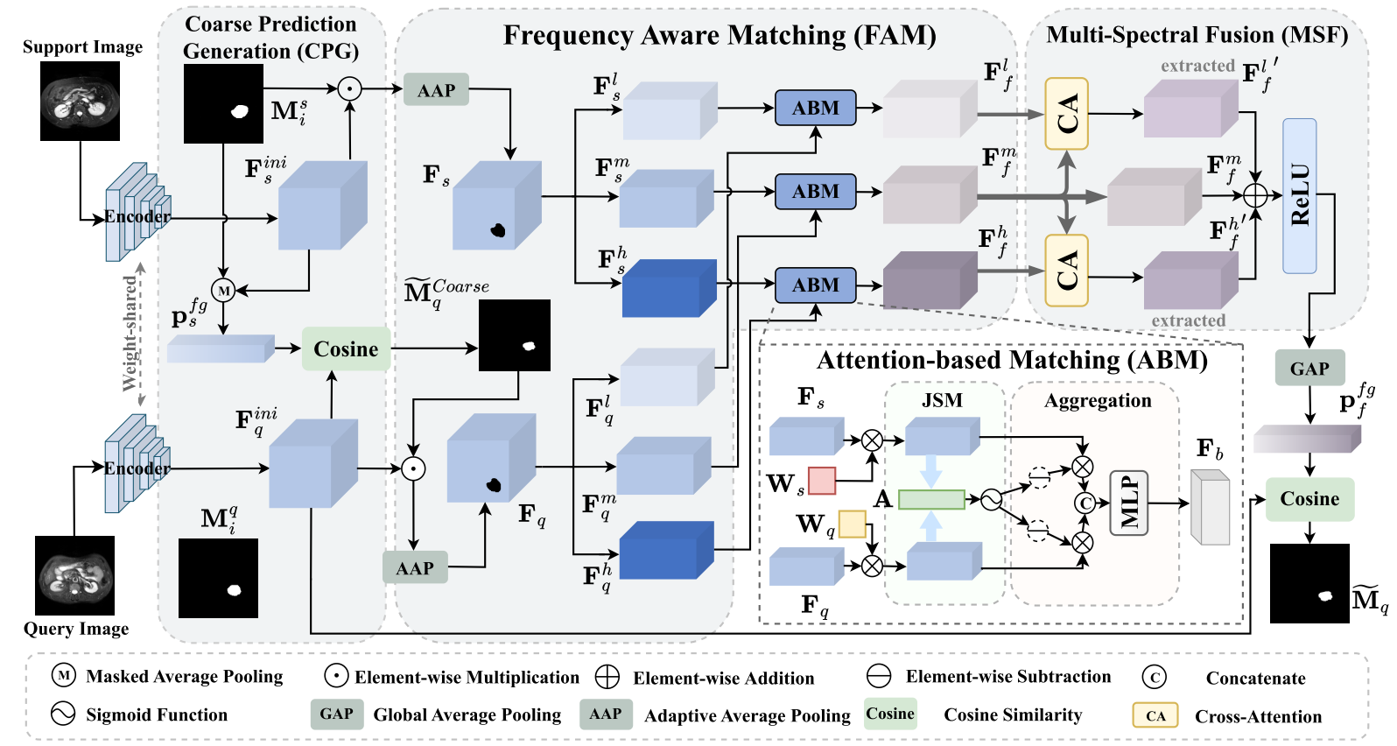
ChongqingUniversity of Technology
ATAI
AdvancedTechniqueof
Artificial Intelligence
ATAI
ChongqingUniversity _{AdvancedTechniqueof}
of Technology Artificial Intelligence
Overview

Slide 4

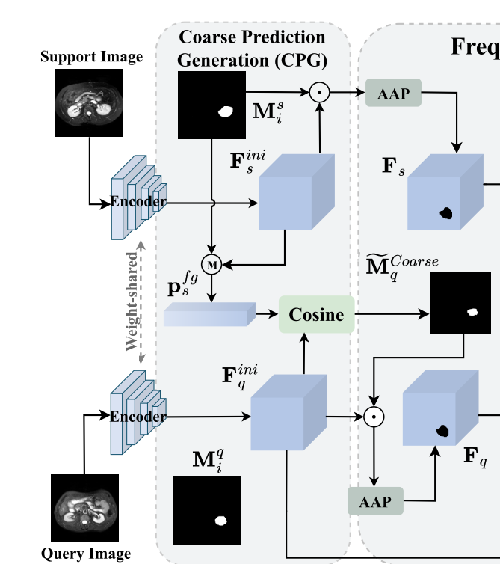






ChongqingUniversity of Technology
ATAI
AdvancedTechniqueof
Artificial Intelligence
ATAI
ChongqingUniversity _{AdvancedTechniqueof}
of Technology Artificial Intelligence
Method
C×H×W
a Coarse Prediction Generation (CPG) module
for generating a coarse prediction of the query mask.
Notes:
一个可变掩码阈值矩阵Θ，通过将查询和键连接到一个全连接网络中来计算

Slide 5
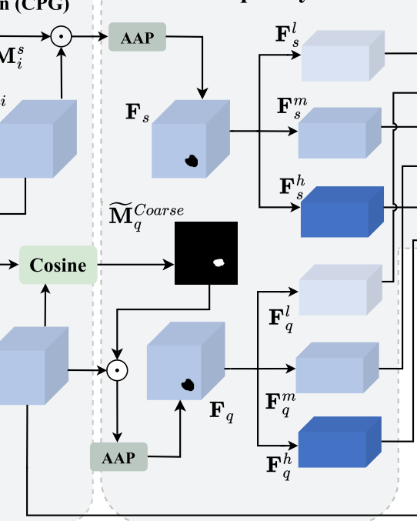

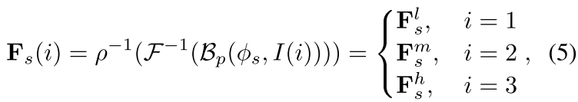


ChongqingUniversity of Technology
ATAI
AdvancedTechniqueof
Artificial Intelligence
ATAI
ChongqingUniversity _{AdvancedTechniqueof}
of Technology Artificial Intelligence
Method
a Frequency-aware Matching (FAM) module
for performing frequency-aware matching between support and query foreground features.
Multi-Spectral Decoupling of Foreground Features
C×N
C×$\sqrt{N}×\sqrt{N}$

Slide 6
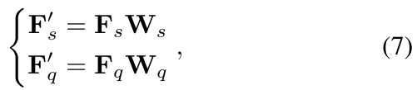
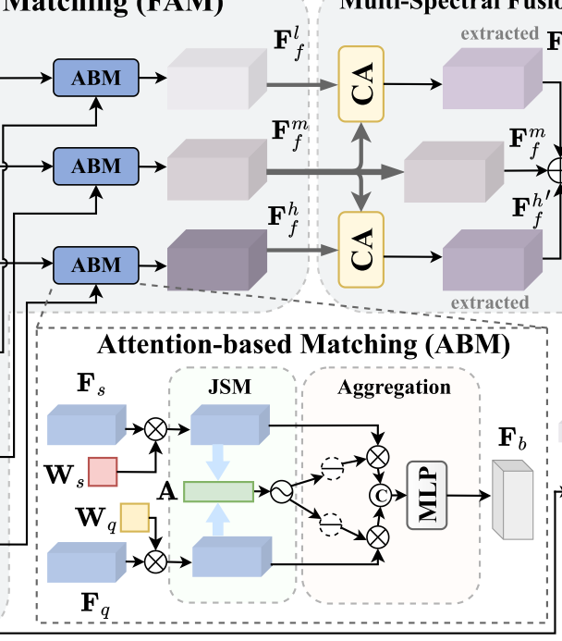
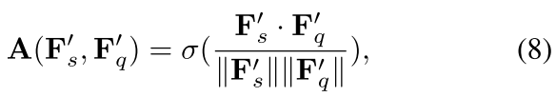
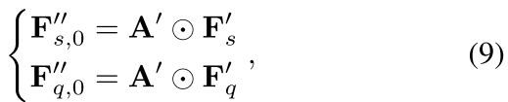
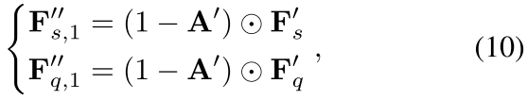
ChongqingUniversity of Technology
ATAI
AdvancedTechniqueof
Artificial Intelligence
ATAI
ChongqingUniversity _{AdvancedTechniqueof}
of Technology Artificial Intelligence
Method
Multi-Spectrum Attention-based Matching
N×N
C×N
1×N
C×N
C×N
C×N

Slide 7
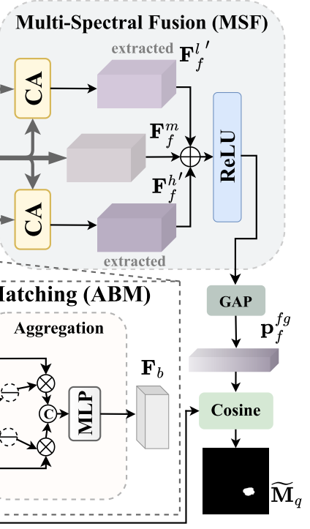

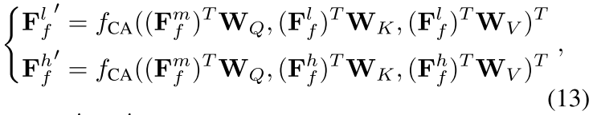

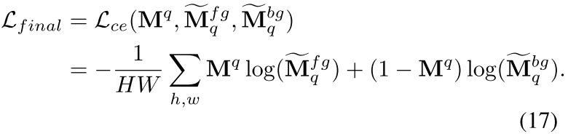
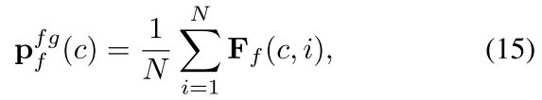

ChongqingUniversity of Technology
ATAI
AdvancedTechniqueof
Artificial Intelligence
ATAI
ChongqingUniversity _{AdvancedTechniqueof}
of Technology Artificial Intelligence
Method
a Multi-Spectral Fusion (MSF) module
for fusing features based on their respective frequency bands.

Slide 8

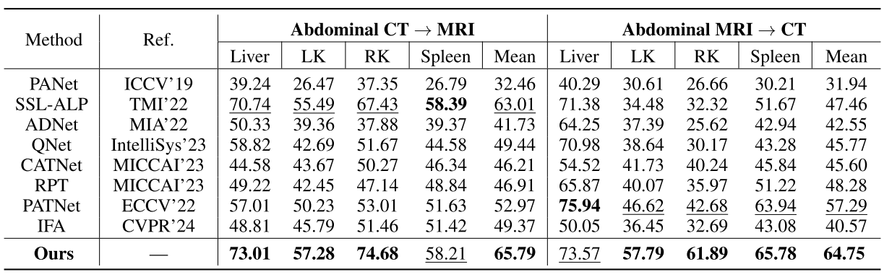
ATAI
AdvancedTechniqueof
Artificial Intelligence
ATAI
ChongqingUniversity _{AdvancedTechniqueof}
of Technology Artificial Intelligence
ChongqingUniversity of Technology
Experiments

Slide 9
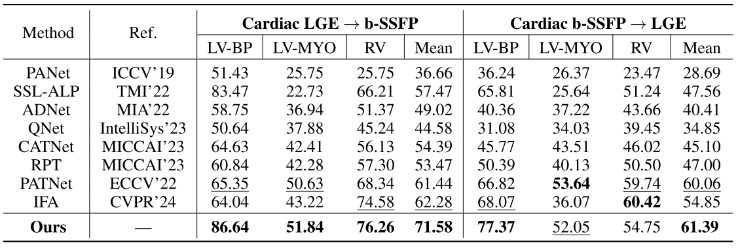
ATAI
AdvancedTechniqueof
Artificial Intelligence
ATAI
ChongqingUniversity _{AdvancedTechniqueof}
of Technology Artificial Intelligence
ChongqingUniversity of Technology
Experiments

Slide 10
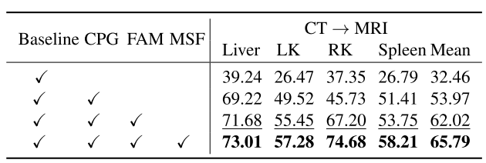
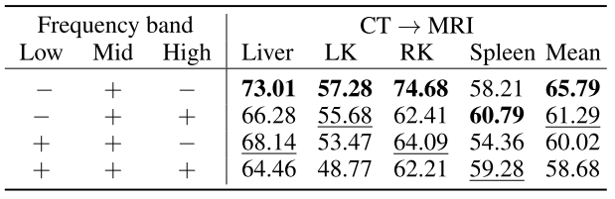
ATAI
AdvancedTechniqueof
Artificial Intelligence
ATAI
ChongqingUniversity _{AdvancedTechniqueof}
of Technology Artificial Intelligence
ChongqingUniversity of Technology
Experiments

Slide 11


ChongqingUniversity of Technology
ATAI
AdvancedTechniqueof
Artificial Intelligence
ATAI
ChongqingUniversity _{AdvancedTechniqueof}
of Technology Artificial Intelligence
Thanks!

